Slide 1
Library of Exceptions and oos in crms
Draft of specification
Work in progress
OPTI / T&I / OPR
February 2022

Slide 2
Exceptions
OOS

Slide 3
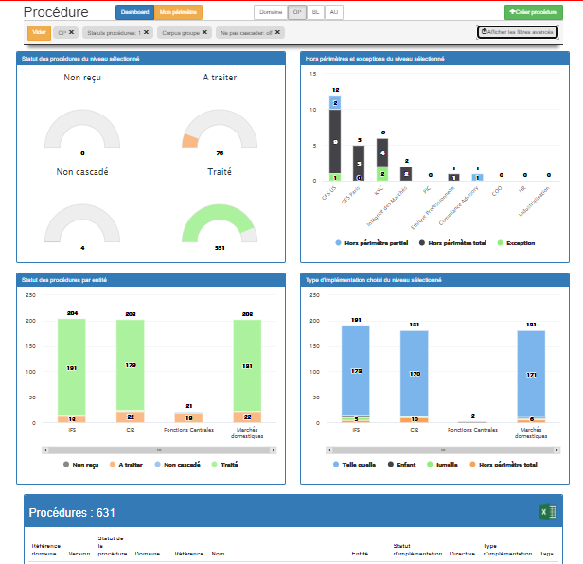
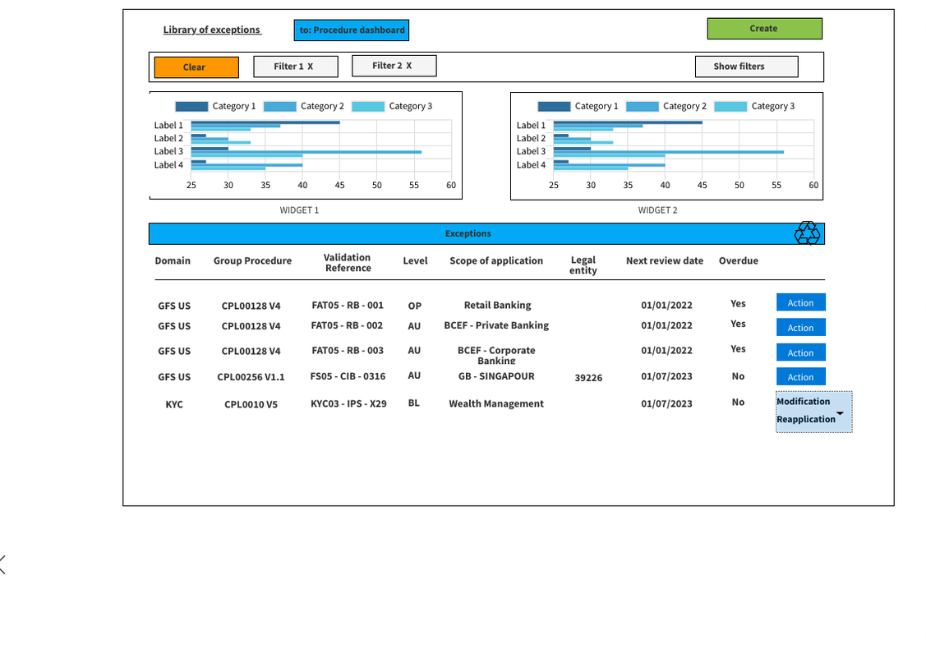
Dashbord exceptions
Library of exceptions as a miror of the library of procedures
Library of exceptions & OOS

Slide 4
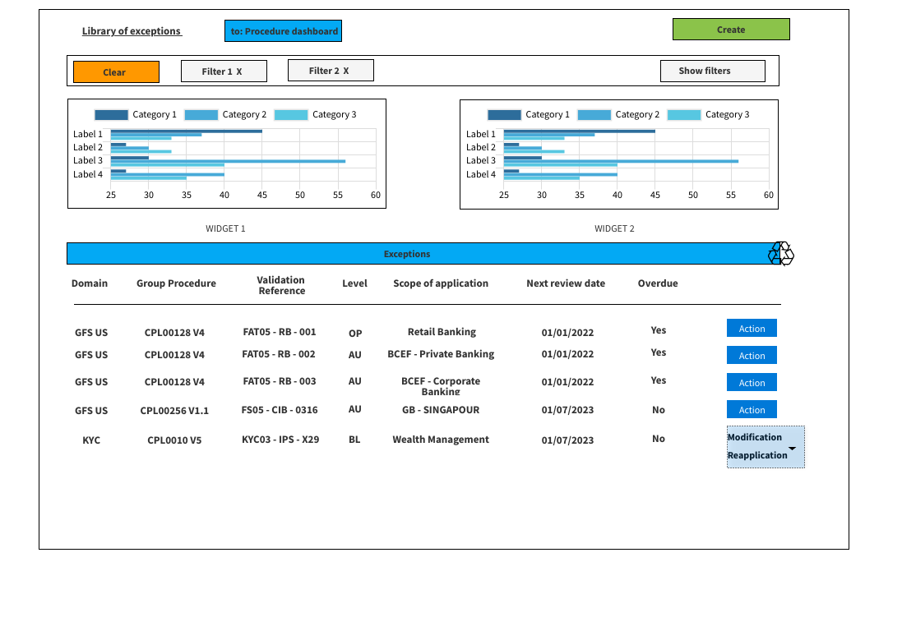

Dashboard exceptions
Main features
Button to go back to the library of procedures
Search tool (see further)
Button to create an exception
Widgets (TBD) : visually display statistics
List of exceptions :
1 line = 1 exception
Select 1 line to open the exception form
Reverse chronological order (fist line = latest exception)
Action button : depending on the user profil and context 2 options are proposed : Reapplication / Modification
Option to hide the exceptions which are overdue ?

Slide 5

Dashboard - rules
All roles can access the dashboard : admin, contributor, reader, controller
Access rights : you can see all the exceptions that apply to your AU(s) (i.e within the juridictions granted to your role)
I can see all the exceptions applying to the AU in my juridictions whatever the domains granted to my rôle
For exemple I can see a BL level exception if « my » AU is included
Widgets (suggestion) :
Procedure implementation delay : less than 6 months, more than 6 months …
Number of exceptions by Domain, OP or BL
Top 10 of procedures with exceptions
Exceptions which are overdue …
Action button : depending on the user profil and context, 2 options are proposed : Reapplication / Modification (wording TBC)
See further
Possibility to sort the exceptions for each column

Slide 6
Main principles
Usecases :
Creation of an exception
Cancelation (in case of error for exemple) : no data registered
Modification :
scope of application or
Next review date
Reapplication on a new version of the procedure
Closure : exception no more relevant or needed because the context has changed (data registered for audit trail)
Access rights :
Only Core Business admin (=Pole), BL admin and contributors have access right in creation and/or modification
Scope of application : the scope of application of the exception must be within the juridictions granted to the role (if 1 AU is missing in your juridictions you cannot modify an exception)
Level of the exception : options to be discussed
Validation workflow outside CRMS => each role can create or modify an exception at the same level of organization or lower
Or only a « higher » role can modify an exception
In the case the exception is no more relevant or needed because the context has changed (for exemple the entity has deployed the expected controls) : should we let the exception « live » or should we stop it prior to its next review date ?
Admin Domain
Admin OP
OP
Admin Domain
Admin OP or BL
Region
Admin OP
Admin BL
BL
Admin OP
Admin BL
Contributor
AU

Slide 7

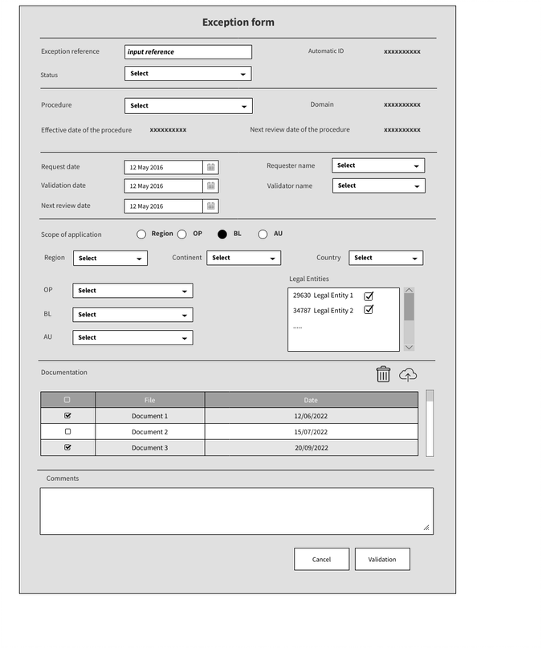
Creation of an exception
Main features
Exception reference : free text (EP reference ?)
Selection of 1 procedure (the domain is automatically displayed once procedure is selected as well as Effective date & Next review date of the procedure)
Next review date of the exception is defined by the user : max = validation date + 3 years
Definition of the level of the exception (Region, Pole, BL, AU) to display the filters
Definition of the scope of application (see further)
Upload n documents
Add comments

Slide 8
Creation of an exception - rules
Who can create an exception : Core business (pole) admins, BL admins and contributors
For which procedure : All procedure related to the domains granted to their role
On which scope of application : Any AU(s) within the juridictions granted to their role
Definition of the level of the exception :
The selection of the level of the exception depends on the role of the user
A Core Business admin (Pole) can create a Region, Pole, BL or AU level exception
A BL admin can create a BL or AU level exception
A contributor can only create an AU level exception
All fields are mandatory except the uploading of document and the comments
No control dates or names (link to Refog)
Reference : definition TBC
Can we have more than 1 reference for an exception ?
Do we need to link several exceptions ?
Pending points :
Status of the exception : is it relevent ?
Suggestion : Alert the user if an exception already exists on the same procedure and the same scope ?
Creation | Core Business Admin | Business Line Admin | Contributor
Region | X | X
Pole | X
BL | X | X
AU | X | X | X

Slide 9
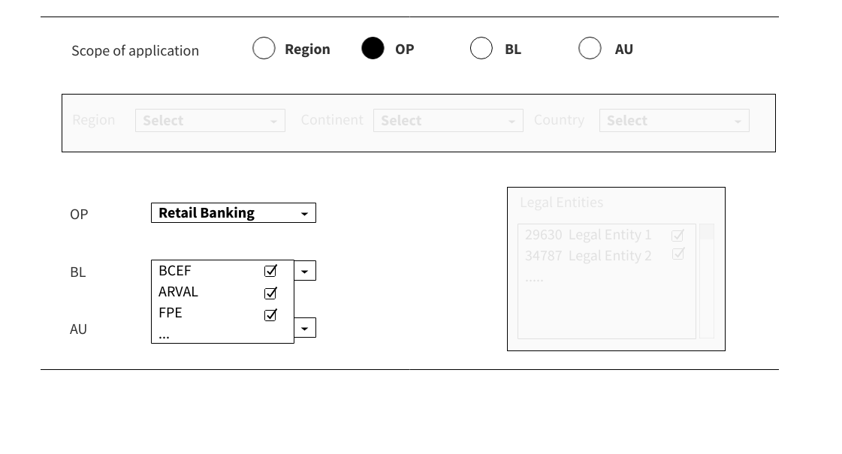
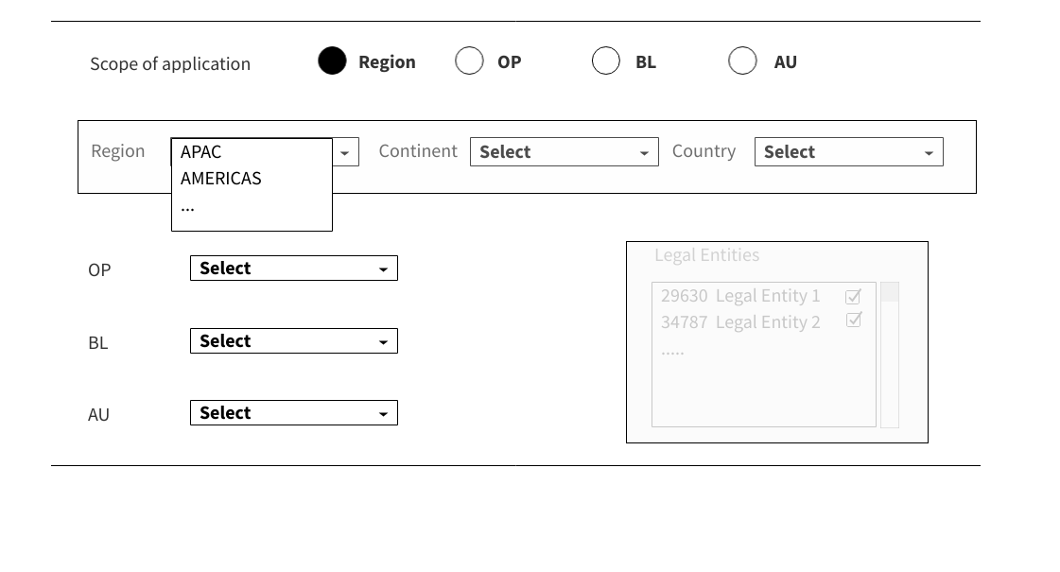
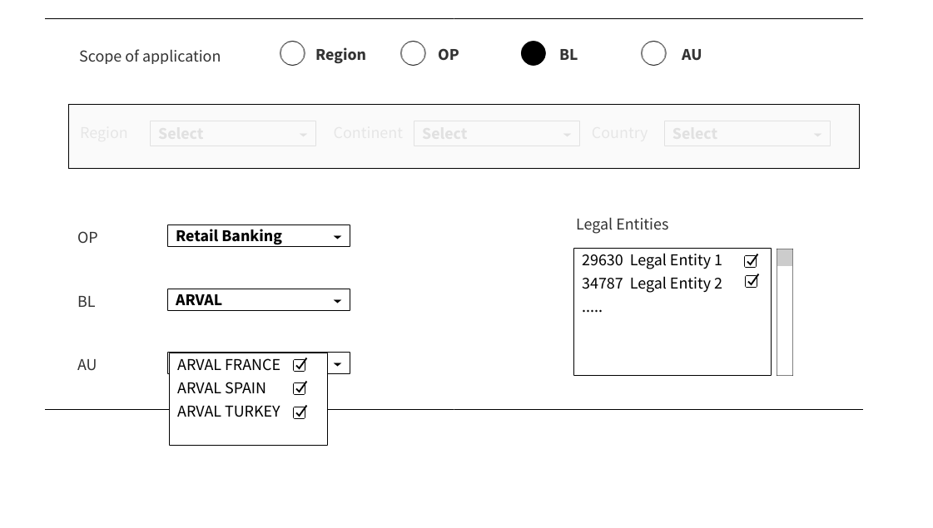
Creation of an exception
Exception at OP level
Select 1 OP
Select 1 to n BL(s) in this OP
Select 1 to n AU(s) included in the BL(s) selected
NB: by default all the BL(s) and AU(s) are selected
exemples of scope of application
Exception at Region level
Exception at BL level
Select 1 OP
Select 1 BL in this OP
Select 1 to n AU(s) included in this BL
NB : by default all the AU(s) are selected
Select a Region in the drop list
Select 1 to n AU(s) included in this Region
NB : by default all the AU(s) are selected
NB : AU(s) within the juridictions granted to the role

Slide 10
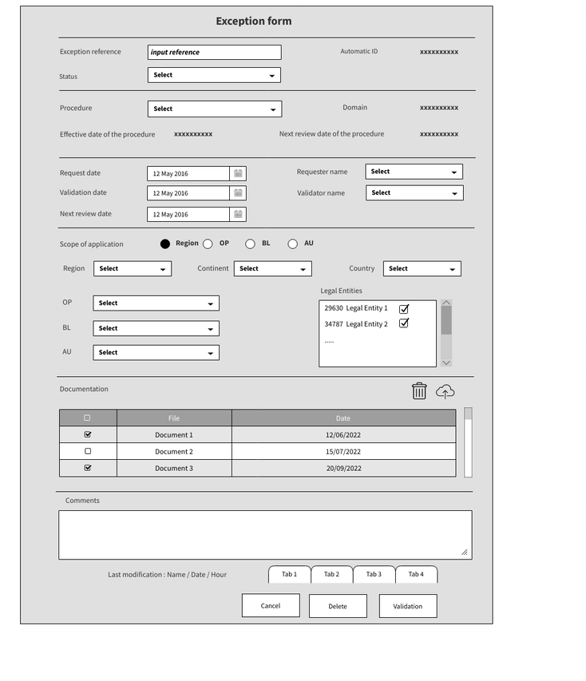

Modification of an exception
Main features
Usecases : change the scope of application or extend the duration
All fields are modificable at any time except :
the reference of the procedure
the level of the exception (Region, Pole, BL, AU)
Each modification validated is registered with name and date (see tabs)
Max new “next review date” = initial “next review date” + 3 years
Modification of the scope of application depending on the level of the exception (add or remove AU or BL)
Upload n documents
Add comments
Delete button : TBC
Possibility to give an end to the exception : “Close” button or “status” modification

Slide 11
Modification of an exception - rules
Who can modify what :
Rule 1 : the level of the exception has to be authorized by your role
Rule 2 : the scope of application of the exception is included in the juridictions of your role
All fields can be modified except :
Procedure (and domain)
Level of the exception
Other data ?
The historic of the modifications are displayed in the tabs
User name and date of the last modification validated are registered
Suggestion :
Alert if an exception already exists on the procedure and the same scope of application ?
Modification | Core Business Admin | Business Line Admin | Contributor
Region | X | X
Pole | X
BL | X | X
AU | X | X | X
Draft for discussion

Slide 12
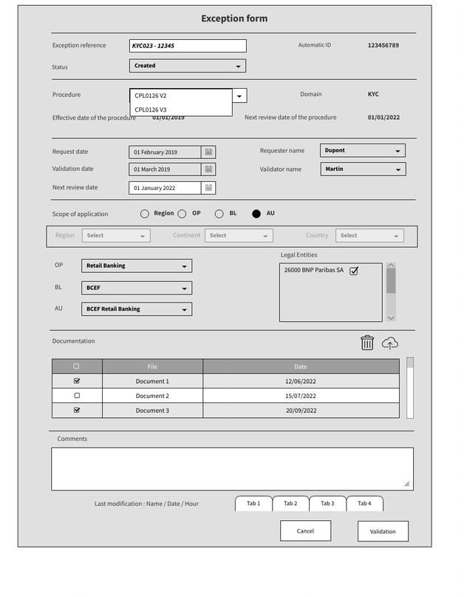
Reapplication of an exception
Main features
Usecases : reapplicate the exception on a new version of the procedure
The reference of the procedure is modificable :
All the versions in « created » status should be display in a drop list
Select the version to apply
The exception reference is modificable ?
Each modification validated is registered with name and date (see tabs)
Upload n documents
Add comments

Slide 13
Reapplication of an exception - rules
Trigger : option available if a new version of the procedure in « created » status is detected
Who can modify what :
Rule 1 : the level of the exception has to be authorized by your role
Rule 2 : the scope of application of the exception is included in the juridictions of your role

